Slide 1

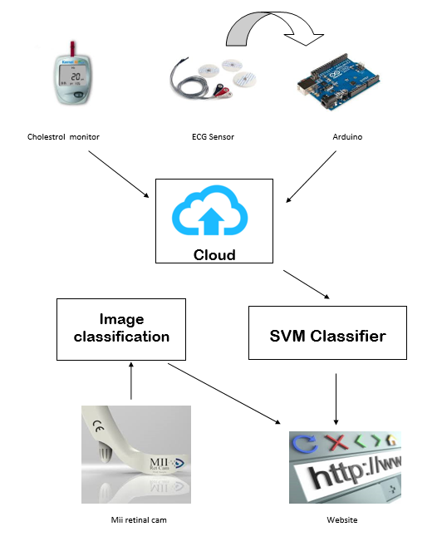
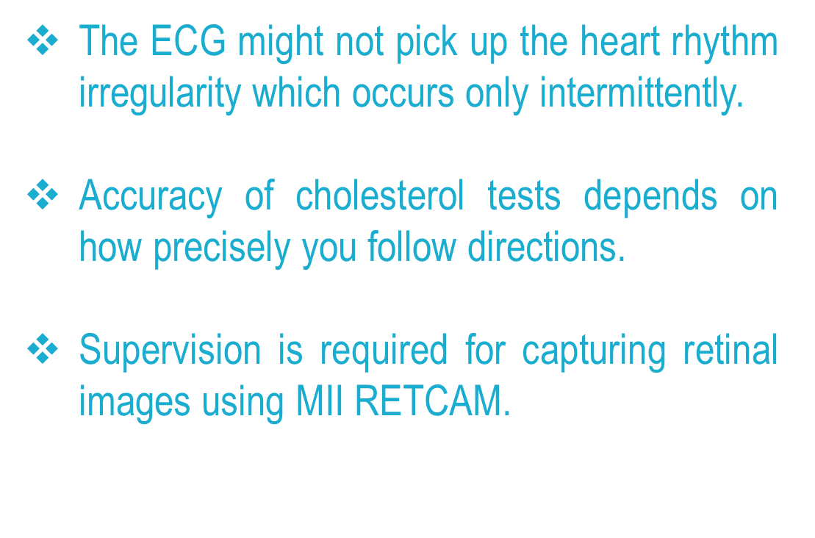
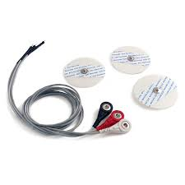
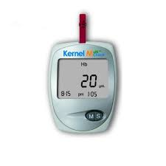
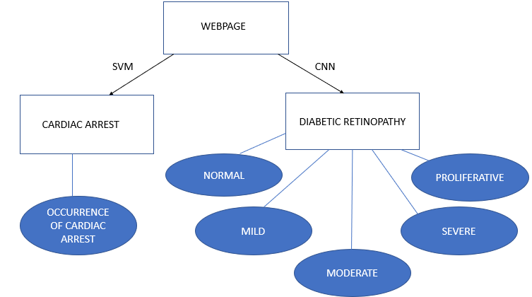
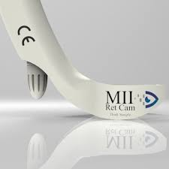
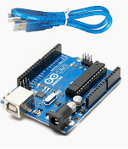
DOC-YOURSELF
Done By
Aravind.S Harini.S Ishwarya.R Balaji.U
IT IT IT IT
Guided By
Dr. S.Sasirekha , Dr.I.Joe Louis Paul
Associate Professors, Department Of Information Technology
Introduction
System Model
Advantages
Diabetes is a well known medical condition that affects an estimated 8.3% of the adult population and is associated with a 2-to-3-fold increased risk for sudden cardiac arrest.
Diabetic retinopathy is one of the leading causes of blindness in the world and affects up to 40% of diabetic patients, with nearly 100 million cases worldwide as of 2010.
The main objective of the project is to predict the occurrence of cardiac arrest and retinal issues in diabetic patients.
Since deaths related to cardiac arrests in diabetic patients cannot be determined accurately in the early stages using the traditional systems, a more accurate way of doing that is possible using machine learning algorithms .
Also, retinal issues in diabetic patients are dealt with image classification which provides accurate results.
It works as a handy tool for the diabetes patients which predicts the cardiac arrest probability and addresses retinal issues.
Using pervasive technology such as a mobile phone, small wearable ECG sensor it is possible to collect the user's symptoms and to detect the onset of a heart attack by analysing the ECG recordings and cholesterol sensors.
It helps the diabetic patients to take up the tests regularly from their home.
The patients get the timely reports for the tests they take up.
Limitations
Working Methodology
This project is a collaboration of retinopathy and cardiology, where the live feed data is pre processed, null-filled and fed to the model using advanced message queuing technique which is used to predict the result dynamically on a pre trained model.
For retinopathy the image obtained as multi-channelled image is fed to CNN which is supported by multiple convolution layers and pooling layers.
The reduced weighted final parameters are inputted to a fully Connected layer as final layer of CNN using Adaptive optimizer as loss function, this model produces a categorical classification result on output layer.
For cardiology, ECG rate, cholesterol, resting blood pressure and other parameters of diabetic patients are analysed via ECG sensors, cholesterol monitoring device and the values are transmitted to the Arduino.
The inputs are converted to a csv file and fed to the SVM model(support vector machine algorithm) and the occurrence of an arrest is predicted beforehand.
Hardware/Software Requirements
AD8232 ECG Monitor Sensor Module is required for monitoring the values of heart rate, ECG, resting blood pressure.
MIHTRA 2-IN-1
.
MII RETCAM
It is required for retinal imaging.
ARDUINO
Expected Results
The data is fetched from the various monitoring devices and are then fed to the ML model and the results are displayed on a webpage.
Glucose and Cholesterol Monitor (Bluetooth) is required for recording the cholesterol values diagnosed in our body.
A
B
Consists of both microcontroller and IDE for building digital devices and interactive objects that can sense and control both physically and digitally.
Conclusion
Thus this system partially does the job of a doctor for diabetic patients.
In Diabetic retinopathy, we propose a CNN approach from digital fundus images and SVM classifier is used in case of cardiac arrests.

